Slide 1

Let’s start with Allah Yaar
Bs in Computer Science

Slide 2
Storage Devices Overview
Storage devices are hardware components designed to hold digital data so it can be accessed and used when needed. These devices range from large-scale storage solutions for data centers to portable drives for personal files.
Characteristics, Uses, Media, Advantages, and Disadvantages
Each type of storage device has unique attributes that make it suitable for specific tasks and environments.
Characteristics: Key attributes like storage capacity, speed, durability, and physical size. Some storage devices are faster, while others offer more storage for lower costs. These characteristics determine the device's suitability for specific tasks.

Slide 3
Storage Devices Overview
Uses: The purpose of each device can vary—some are ideal for system storage, others for backup, data transfer, or multimedia storage.
Media Types: Refers to the underlying technology—either magnetic, optical, or solid-state—which affects durability, speed, and capacity.
Advantages: Each type has its strengths, like high capacity, portability, or quick data retrieval.
Disadvantages: Potential downsides include limited lifespan, slower speeds, susceptibility to damage, or cost.

Slide 4
Types of Storage Devices
There are three main types of storage technologies: Magnetic, Optical, and Solid-State. Each has its own set of subtypes and specific use cases.
1. Magnetic Drives
Magnetic storage devices use magnetic fields to encode data. Data is stored on a magnetized medium, often on spinning disks or on magnetic tape.
Fixed Magnetic Hard Drives (HDDs)
Portable Magnetic Hard Drives
Magnetic Tape Drives

Slide 5
Types of Storage Devices
Fixed Magnetic Hard Drives (HDDs)
Characteristics: Fixed HDDs are built into computers and are the primary storage medium in many systems, offering substantial storage capacity at an affordable price.
Uses: Ideal for storing operating systems, applications, large files, and data on computers and servers.
Advantages: High capacity, reliable, and affordable for large storage needs.
Disadvantages: Slower than SSDs, less durable due to moving parts, sensitive to physical shocks.

Slide 6
Types of Storage Devices
Portable Magnetic Hard Drives
Characteristics: These are external hard drives connected to computers via USB, Thunderbolt, or other ports, making them portable for data transfer.
Uses: Frequently used for backups, file transfers, and additional storage capacity.
Advantages: High capacity and portable, offering an easy way to expand storage or move data between devices.
Disadvantages: Susceptible to data loss if dropped or damaged; slower than SSDs.

Slide 7
Types of Storage Devices
Magnetic Tape Drives
Characteristics: Magnetic tape is wound onto reels and used to store data sequentially, with high capacity and long retention.
Uses: Commonly used for long-term data storage and backups in industries where large amounts of archival data are stored.
Advantages: High storage capacity, cost-effective for long-term storage.
Disadvantages: Slow read/write times due to sequential access; mainly used in specialized environments due to this limitation.

Slide 8
Types of Storage Devices
2. Optical Drives
Optical storage devices use laser technology to read and write data on discs. They are popular for media storage, including audio, video, and software distribution.
CD (Compact Disc) Drives
DVD (Digital Versatile Disc) Drives
Blu-ray Drives

Slide 9
Types of Storage Devices
CD (Compact Disc) Drives
Characteristics: CDs typically hold up to 700 MB, using laser technology to store data as tiny pits and lands on the disc surface.
Uses: Commonly used for audio storage, software distribution, and storing smaller amounts of data.
Advantages: Portable, durable if handled carefully, and inexpensive.
Disadvantages: Limited storage capacity, outdated for larger data needs, easily scratched or damaged.

Slide 10
Types of Storage Devices
DVD (Digital Versatile Disc) Drives
Characteristics: DVDs hold more data than CDs (up to 4.7 GB for single-layer, 8.5 GB for dual-layer) and are commonly used for video storage.
Uses: Storing movies, larger software applications, and data backups.
Advantages: Higher capacity than CDs, relatively inexpensive, widely available.
Disadvantages: Limited capacity compared to modern alternatives, still prone to scratches and damage.

Slide 11
Types of Storage Devices
Blu-ray Drives
Characteristics: Blu-ray discs have high capacity, up to 25 GB on a single-layer disc and 50 GB on dual-layer, using a finer laser for data storage.
Uses: Commonly used for high-definition video storage, games, and high-capacity data storage.
Advantages: High capacity, supports HD and 4K video, great for large multimedia files.
Disadvantages: More expensive than CDs/DVDs, requires a Blu-ray-compatible drive.

Slide 12
Types of Storage Devices
3. Solid-State Drives (SSD)
Solid-state drives use flash memory with no moving parts, making them faster, more reliable, and energy-efficient compared to magnetic drives.
Fixed Solid-State Drives (SSDs)
Portable SSDs
Pen Drives and Flash Drives

Slide 13
Types of Storage Devices
Fixed Solid-State Drives (SSDs)
Characteristics: Built into laptops, desktops, and tablets as primary storage, SSDs are faster, durable, and smaller than HDDs.
Uses: Primarily used for system storage in laptops and desktops, allowing fast boot times and quick access to files and applications.
Advantages: Extremely fast read/write speeds, shock-resistant, silent, lower power consumption.
Disadvantages: Higher cost per GB compared to HDDs, some models have a limited number of write cycles.

Slide 14
Types of Storage Devices
Portable SSDs
Characteristics: External SSDs that connect via USB, Thunderbolt, or similar interfaces; they are lightweight, compact, and rugged.
Uses: Ideal for fast, portable data storage and backup, frequently used by professionals needing high-speed data transfer.
Advantages: Very fast data transfer rates, portable, resistant to physical shock.
Disadvantages: More expensive than HDDs, storage capacity might be lower than equivalent-priced HDDs.

Slide 15
Types of Storage Devices
Pen Drives and Flash Drives
Characteristics: Small, USB-connected devices with flash memory, typically ranging from a few GB to hundreds of GB in storage.
Uses: Convenient for quickly transferring and storing files between computers or temporarily storing data.
Advantages: Compact, highly portable, affordable, easy to use.
Disadvantages: Limited storage capacity compared to SSDs, can be lost easily due to their small size, some models have limited write cycles.

Slide 16
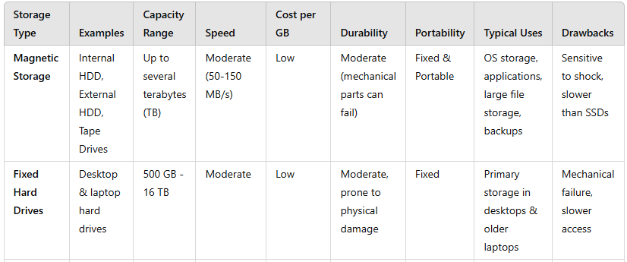
Summary Table

Slide 17
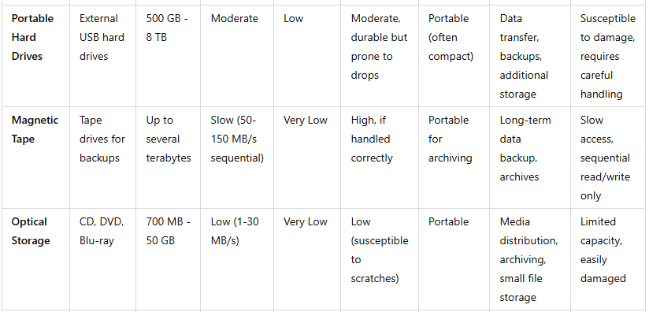
Summary Table

Slide 18
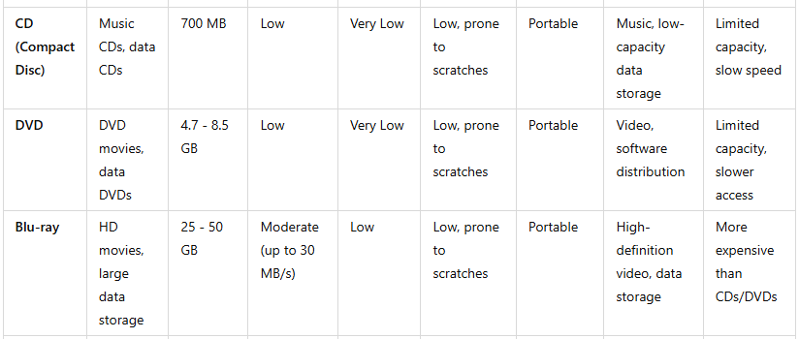
Summary Table

Slide 19
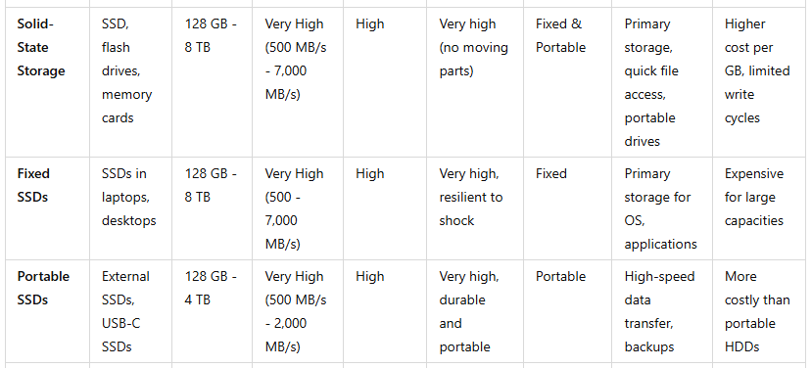
Summary Table

Slide 20
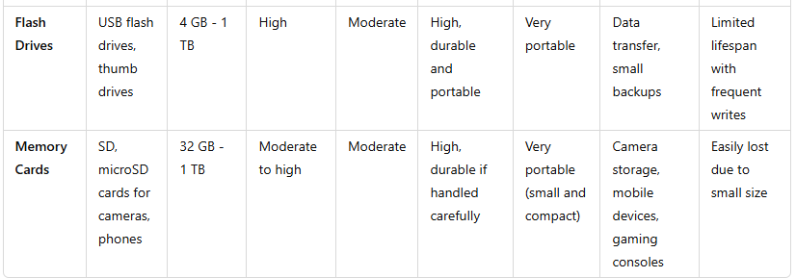
Summary Table

